Slide 1
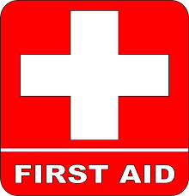
7th and 8th Grade First Aid
Mrs. McWilliams

Slide 2
Your Responsibilities as a Responder
Check the Scene- make sure it is safe
Call Emergency Responders- the most important step!
Provide Care
The 3 C’s of Responding
Check
Call
Care

Slide 3
Good Samaritan Laws
• Laws that give legal protection to people who help individuals that are ill or injured
• Protect one from being sued or found financially responsible for the victim’s injury
• Protect you as long as you are not negligent or reckless during the care that is given

Slide 4
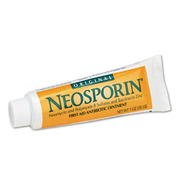
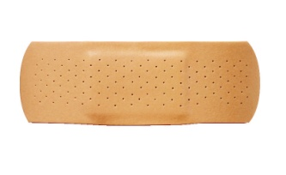
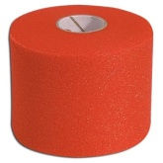
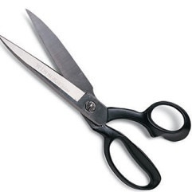
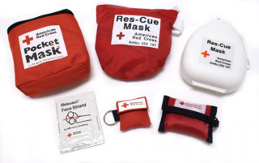
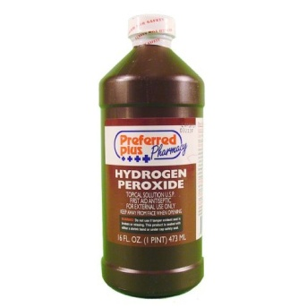
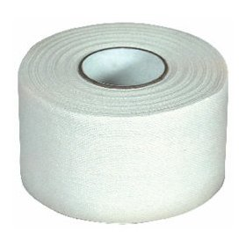
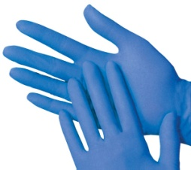
What are some things that would be important to include in a First Aid Kit?
Where are some convenient places to keep First Aid Kits?

Slide 5
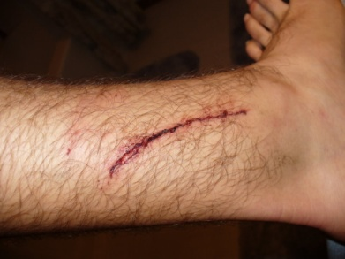
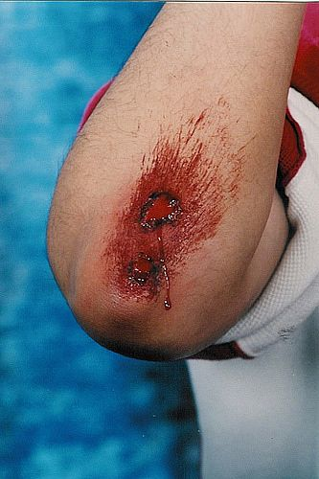
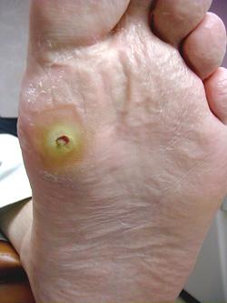
Wound Types
Laceration
A cut in the skin that is usually deep enough to require stitches
Abrasion
A scrape or burn
Puncture
A hole in the skin caused by a sharp object

Slide 6
 | TREATMENT OF WOUNDS
Laceration | Clean the wound with soap and water, or peroxide. Use a clean cloth to apply pressure. Use an antibiotic cream to prevent infection Apply a sterile bandage Tightly.
Abrasion | Clean the wound with soap and water or Peroxide Use a clean cloth to apply Pressure Use an Antibiotic cream to prevent infection Apply a sterile bandage Loosely
Puncture | **If the wound is Deep or in a critical area, leave the foreign object in! Call 911 and Immobilize the object.** For minor punctures, completely remove foreign objects Use a clean cloth to apply pressure Use an antibiotic cream to prevent Infection Apply a sterile bandage

Slide 7
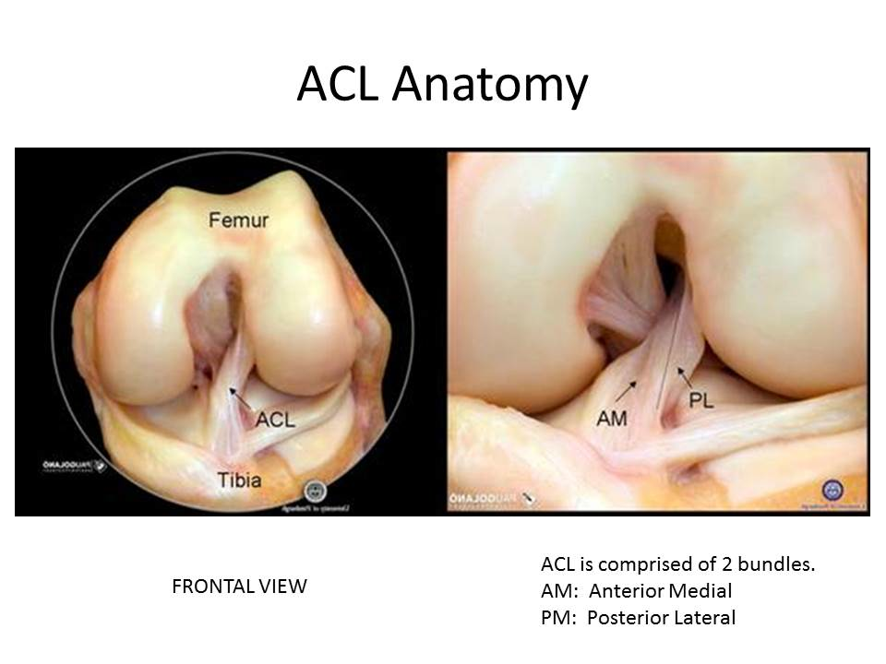
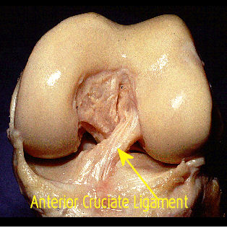
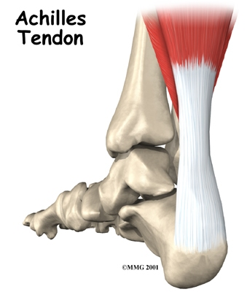
Soft Tissue Injuries
Sprains- the stretching or tearing of a ligament (connect bone to bone)
Strains- the stretching or tearing of a tendon (connect muscle to bone or muscle to muscle)

Slide 8
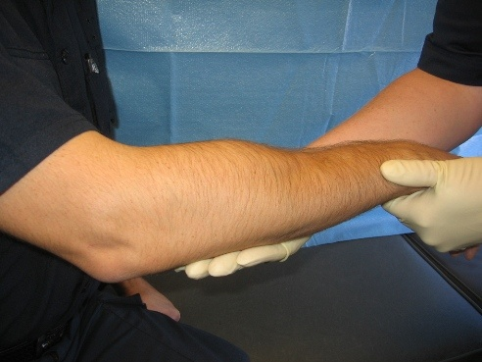
Fractures
Simple Fracture
A broken bone that does
not break through the skin
Compound Fracture
A broken bone that breaks through the tissue and skin

Slide 9
Treatment of Strains, Sprains, and Fractures
Sprains and Strains
Stop activity right away
Use the RICE method for the first 48 hours after the injury
Use supportive devices when returning to activity such as:
Tape
Braces
Monitor the injury for problems in the future
Treatment for Fractures
Call 911
Stabilize the victim until emergency care arrives
If you must move the victim because the situation becomes unsafe, immobilize the injury.
Fractures require immediate care!

Slide 10
The RICE Method
R: Rest
I: Ice
C: Compression
E: Elevation

Slide 11
Nosebleeds
Treatment Sit down Tilt your head slightly Forward. (Leaning Back may cause blood to flow down the back of the throat, which tastes bad and may cause gagging, coughing or vomiting. Gently Pinch your nose. Use your thumb and Index finger and breathe through your Mouth. Continue for about 5-10 minutes. To prevent further bleeding: Do not Bend Over or Blow Your Nose for several hours after bleeding stops.

Slide 12
Types of Burns
1st Degree:
Only the Epidermis, or outer layer of skin, is burned. The skin usually Red and swells with pain.
2nd Degree:
The Outer layer of skin is burned through and the 2nd layer, called the Dermis, becomes red and blotchy (blistering)
3rd Degree:
A major burn that involves all layers of the skin, tissue, muscle and sometimes even bone. Areas may be charred black or appear dry and white.

Slide 13
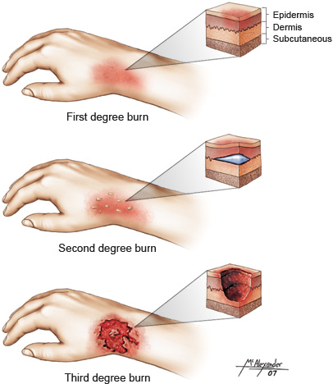

Slide 14
Treatment of Burns
Treatment for Minor Burns
Cool the burn. Immediately hold the burn under Cool Water until the pain subsides. Do not put Ice directly on the burn.
Cover the burn by wrapping it Loosely with Sterile Bandages.
Take OTC (Over The Counter) pain reliever.
Treatment for Major Burns
Call 911 immediately!
Provide care by removing any smoldering or hot materials from the victim.
Do not immerse Major burns in Water.
Check for response and Begin CPR if necessary.
Wrap the burn with cool, moist, sterile bandages or moist towels.

Slide 15
Shock
Shock- a dangerous physical condition in which the flow of blood throughout the body is drastically reduced, causing weakness, confusion, or loss of consciousness.
Treatment
Call 911 first!
Keep them lying down on their back with their feet raised about a foot higher than their head. This helps get the blood flowing to the brain and heart.
Keep them covered with a coat or blankets to keep them warm.

Slide 16
Fainting
Fainting- also called syncope, is a sudden, brief loss of consciousness and posture caused by decreased blood flow to the brain.
Treatment-
Call 911 if the person has blue lips or face, an irregular or slow heartbeat, chest pain, difficulty breathing, is difficult to awaken, or acts confused
Otherwise:
Lay the person flat on his or her back
Elevate the person's legs to restore blood flow to the brain

Slide 17
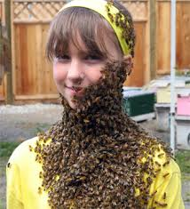
Stings and Bites
Remove the Stinger: Scrape the
area with a fingernail to remove it.
Don't pinch the stinger (that can
inject more venom)
2. Control Swelling: Ice the area.
3. Treat Symptoms: For pain, take an over-the-counter painkiller like ibuprofen. For itchiness, take an antihistamine.
4. Follow-Up: It might take 2-5 days for the area to heal. Keep it clean to prevent infection.

Slide 18
Difference between Heat Exhaustion and Heat Stroke
Heat Exhaustion:
condition whose symptoms may include heavy sweating and a rapid pulse, a result of your body over-heating. Causes of heat exhaustion include exposure to high temperatures, particularly when combined with high humidity, and strenuous physical activity. Without prompt treatment, heat exhaustion can lead to heatstroke, a life-threatening condition.
Heat Stroke:
results from prolonged exposure to high temperatures -- usually in combination with dehydration (which leads to failure of the body’s temperature control system. The core body temperature reaches 105 degrees F or higher. Common symptoms include nausea, seizures, confusion, disorientation, and sometimes loss of consciousness or coma.

Slide 19
Treatment for Heat-Related Illnesses
Treatment for Heat Exhaustion
Call 911 if fainting, confusion, seizures, or a fever.
Move the victim out of the sun and into shade/air conditioning.
Lay the victim down and elevate legs and feet slightly after loosening or removing their clothing if able.
Have the victim drink cool water. Never give food or water to an unconscious victim!
Monitor the person carefully.
Treatment for Heat Stroke
Call 911 immediately!
Move the victim out of the sun and into shade/air conditioning.
Cool the person by covering them with damp towels or spraying them with cool water. Use a fan or newspaper to give them air.

Slide 20
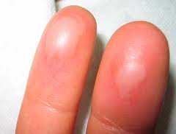
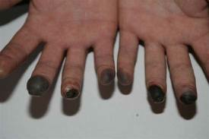
Frostbite
Frostbite: localized damage is caused to skin and other tissues due to freezing.
Treatment:
Call for help! Get the person to a warm place and remove any wet clothing. Do not re-warm the skin until you can keep it warm. Gently warm the area in warm water (not hot) until the skin appears red and warm. Do not use direct heat from heating pads, radiator, or fires. Do not rub or massage the skin or break blisters. Bandage the area loosely and apply dry, sterile dressings.

Slide 21
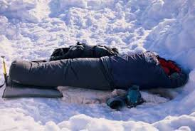
Hypothermia
Hypothermia is a potentially dangerous drop in body temperature, usually caused by prolonged exposure to cold temperatures
Treatment:
Call for help!
Remove any wet clothes
Move gently to a warm, dry shelter as soon as possible.
Begin re-warming the person with extra clothing and use warm blankets.
Offer warm liquids
CPR if no signs of breathing…continue CPR even if there is no pulse.

Slide 22
CPR
CPR stands for Cardiopulmonary Resuscitation
Follow the A, B, C’s!
A: Airway
B: Breathing
C: Control Bleeding
Or AB-CABS like in the video
Video:
http://www.youtube.com/watch?v=ZjszBXF0l8A

